Slide 1
SWDUX 301: DESIGN UI/UX
RQF Level: 333 Learning Hours: 150 Credits: 1515 Sector: ICT & MULTIMEDIA Trade: SOFTWARE DEVELOPMENT Module Type: Specific
Trainer’s name: RWEMARIKA Jean Louis
Academic year 2024/2025

Slide 2
PURPOSE STATEMENT
This module describes the skills, knowledge and attitude required to design UI/UX. This module is intended to prepare students pursuing TVET Level 3 in Software Development. At the end of this module, the students will be able to Analyze User Experience, Define the User and Design Mockup.

Slide 3
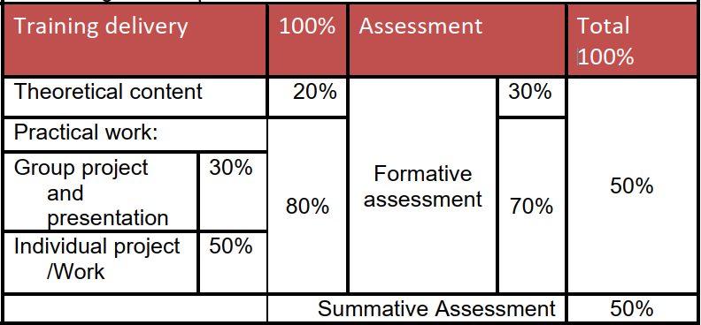

Slide 4
Course outline
LO1: Analyze User Experience
1.1: Definition of Key Concepts
1.2: Description of UX Research
1.3: Analysis of Brand Identity
1.4: Definition of Tasks
1.5: Identification of end-user pain point

Slide 5
LO 2: Define the user
2.1. Definition of key terms
2.2: Creation of user story
2.3: Identification of user person
2.4: Creation of user journey
2. 5: Perform UX Research

Slide 6
III. Design Mockup
3. 1: Description of key concepts
3. 2: Use of Figma prototyping tool
3. 3: Sketch mockup
3.4: presentation of prototype

Slide 7
LO1.Analyze user experience
1.0 Introduction to User Experience (UX) Design
User experience (UX) design refers to the user's journey(the entire process) when interacting with a product or service.
UX design is the process of creating products or services that provide meaningful experiences for users, involving many different areas of product development including branding, usability, function, and design.
.

Slide 8
A UX designer’s primary goal is for each user to have a positive interaction with a product or service.
In the main, the term user experience design is used in relation to websites, web applications and other software applications.

Slide 9
Qualities of a good UX design
Functional: Does it work?
No bugs, errors and outages,
Uses current technologies (doesn’t rely on old technologies like Flash that don’t work on phones or tablets)…..
2. Reliable: Is it available and accurate?
Loads in reasonable time, even in peak periods

Slide 10
Cont’
Content is current and accurate,
Data is clean and reliable
Password resets are sent/received promptly
It can be used effectively on mobile devices and standard device types.
3. Usable: Can it be used without difficulty?
Users don’t get lost or confused
Users can easily find the content or products they are interested in

Slide 11
Cont’
4. Convenient Does it fit in with my life and work the way I want?
Users want to use it
Users actively find situations and reasons to use it more
Users recommended, up-vote and rate it
5. Pleasurable Is it an enjoyable experience that’s worth sharing?
Users invest themselves into it
Users promote, share and evangelize it
6. Meaningful Does it have personal or social significance?
Users ❤ it; it brings meaning to their life

Slide 12
Why is UX important?
When it comes to designing a website or application, user experience is a crucial aspect to consider.
A well-designed interface should be intuitive and easy to use, making the user’s experience seamless.

Slide 13
1.1 Definition of Key Concepts
What is UX design?
User experience (UX) design is the process of building products that are easy and enjoyable for people to use. By building products to be as effortless as possible for users, you can encourage adoption, retention, and loyalty/devotion.
Adoption: transfer between an old system to another(usually better system)

Slide 14
Retention: Remembering
Loyalty: devotion
UX design is all about solving user problems and creating relevant, easy, enjoyable, and accessible experiences.
The user experience relates to how a user feels whenever they interact with a product or service. It’s not a physical, tangible thing—it’s the ease and user-friendliness of the interaction as a whole.

Slide 15
What Is UI Design?
User interface (UI) design is the process designers use to build interfaces in software or computerized devices, focusing on looks or style.
Designers aim to create interfaces which users find easy to use and pleasurable. UI design refers to graphical user interfaces.
The user interface relates specifically to the screens, buttons and other visual and interactive features a person uses to interact with a digital product, such as a website or app.

Slide 16
Quality of the user experience:
a meaningful and valuable user experience, information must be:
Useful: Your content should be original and fulfill a need
Usable: Site must be easy to use
Desirable: Image, identity, brand, and other design elements are used to evoke emotion and appreciation
Findable: Content needs to be navigable and locatable onsite and offsite

Slide 17
Accessible: Content needs to be accessible to people with disabilities
Credible: Users must trust and believe what you tell them
Valuable. Our sites must deliver value to our sponsors. For non-profits, the user experience must advance the mission. With for-profits, it must contribute to the bottom line and improve customer satisfaction.

Slide 18
What is User experience (UX) research?
User experience (UX) research is the study of learning what end users of a system or product need and want, then employing those insights to enhance the design process for products, services or software. UX research can take different forms depending on the area of focus.

Slide 19
What are the Research findings?
Research findings refer to the results obtained from a study or investigation conducted through a systematic and scientific approach. These findings are the outcomes of the data analysis, interpretation, and evaluation carried out during the research process.

Slide 20
Examples of User Experience
Let's take as an example an e-commerce website.
If a customer finds the buying experience to be long, complex, and complicated, then her UX will be a bad one.
Say instead her purchasing experience is easy and hustle-free, then the UX will be considered a good one

Slide 21
What is a UX Designer?
A UX designer is someone who investigates and analyzes how users feel about the products he or she offers them.
UX designers then apply this knowledge to product development to ensure that the user has the best possible experience with a product.

Slide 22
Difference between UX and UI
While UX is the internal experience of customers as they interact with any aspect of a product/service, UI is the sum of all the visual elements of a product/service that you interact with when using a website, app, or other electronic device.
UI is all about screens, pages, icons; it of course contributes to making an experience better (or worse) but it is just a part of the whole.
UX refers to the entire interaction you have with a product, including how you feel about the interaction.

Slide 23
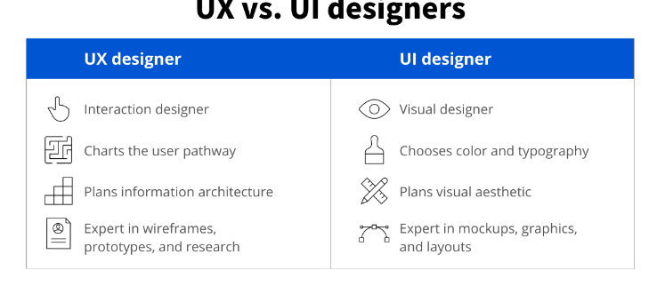

Slide 24
Tasks and responsibilities
UX designers focus their work on the experience a user has with a product.
The goal is to make products that are functional, accessible, and enjoyable to use.
UI designers create the graphical portions of mobile apps, websites, and devices; the elements that a user directly interacts with.

Slide 25
User interface: The means by which a person interacts with an application or hardware device
Typography: The style and appearance of written material; the art of making type legible, readable, and appealing
Prototype: A sample or simulation of a final product used to test and gather feedback
Wireframe: A layout displaying functional elements of an interface

Slide 26
1.3 Description of UX Research
User experience (UX) research is the process of collecting, processing, analyzing data, finding weak points in the product, suggesting ways to fix them, and testing solutions with the users to get real feedback.
User experience (UX) design requires you to understand the pains and pleasures of your users—and user research is the way in which to do just that.

Slide 27
“User research is how you will know your product or service will work in the real world, with real people. It’s where you will uncover or validate the user needs which should form the basis of what you are designing.”

Slide 28
Research findings(review)
Findings are basically the key outcome of the investigation. Or are the information they get or the conclusions they come to as the result of an investigation or some research.
It is basically a key fact which you can discover during an investigation.

Slide 29
Research is work that involves studying something and trying to discover facts about it.
Research findings are facts and phrases, observations, and experimental data resulting from research.

Slide 30
1.4 UX research methods and approaches
Common UX research methods are:
Usability testing
User interviews
Surveys
Card sorting
Tree testing
Field studies
And more.

Slide 31
To choose the right UX research method for your project, you first need to understand the problem you're trying to solve and what data you need to collect to solve the problem.

Slide 32
1. Usability Testing: Usability testing is the observation of users trying to carry out tasks with a product.
Usability Testing: Giving test users a list of tasks to perform with a product. Users may test a product remotely or in a facility with a moderator guiding them.

Slide 33
2. User Interviews: Asking questions of a single user at a time to find that user’s needs, ideas, attitudes, and experience of the product or service.
A user interview is a UX research method during which a researcher asks one user questions about a topic of interest (e.g., use of a system, behaviors and habits) with the goal of learning about that topic.

Slide 34
3. Surveys:
Survey research means collecting information about a group of people by asking them questions and analyzing the results. To conduct an effective survey, follow these six steps:
Determine who will participate in the survey
Decide the type of survey (mail, online, or in-person)
Design the survey questions and layout
Distribute the survey
Analyze the responses
Write up the results

Slide 35
4. Card Sorting: Presenting users with movable pieces of a website’s information, encouraging them to rearrange the information into their preferred structure/ categories that make sense to them.
Card sorting aims to get the users to group information in a way that makes sense to them. This helps you understand your users’ mental models, and thus determine the best way to organize your site content.

Slide 36
4. Tree testing: you present the user with a very basic visual representation of the structure of your product.
Tree testing in UX reveals how easy it is for visitors to access content on your website. It determines whether the structure of your website conforms to what users expect it to be.
In tree testing, testers are given descriptive tasks and must choose a location where they expect the answer to be.

Slide 37
6. Field studies: It aims to observe, interact and understand people while they are in a natural environment.

Slide 38
1.4.1 UX Research role and responsibilities
UX Researcher responsibilities include:
Meeting clients to gather information about their requirements and to find out what needs researching, designing, or usability testing
Getting involved in sketching, prototyping, and user testing before passing the design onto the development team
Applying qualitative research methods to client projects based on their needs and goals

Slide 39
1.4.2 Benefits of UX Research
1. Make informed decisions based on data:
it helps you understand user behaviors and make better, more informed decisions.
UX research helps reduce and mitigate the risk of building the wrong thing or building the right thing in the wrong way.
2. Remove bias from the user experience design process
An effective way to remove bias from the design process is to ask effective questions.
3. Test and validate concepts
UX research allows you to test and validate ideas early, without waiting for launch day to gather feedback.

Slide 40
4. Work on solutions that bring real value to customers:
Another main benefit of UX research is that it allows product managers to manage risks.
"That is, making sure that we're using our most precious resource—time—to work on solutions that are valuable to our users,"
5. Successfully take products to market:
UX research plays a crucial role in helping product marketers understand customer needs and effectively communicate the product's value to the market.

Slide 41
1.4.3Types of UX Data
UX research includes two main types:
Quantitative UX Data (statistical data): Helps you to identify what issues your users experience, and their degree of severity.
Qualitative UX Data (insights that can be observed but not computed) : Gives you an understanding of why and how these issues affect your users, and how to fix them.

Slide 42
Difference between Qualitative and quantitative user research methods
The primary differences between qualitative and quantitative UX research have to do with how the data is collected and the nature of the data itself.
Quantitative user research
Is the process of collecting and analyzing objective, numerical data from various types of user testing.

Slide 43
Quantitative UX research, usually involves collecting data from a much larger group of people in order to quantify a problem by answering the questions, “How much?” and “How many?”
Qualitative UX research typically involves collecting data through direct observation of a small group of people in order to assess behavior and answer the question: “Why?”

Slide 44
Steps of UX analysis Identification of user issues
UX analysis is all about organizing your data and looking for patterns and recurring issues
Six steps to UX analysis:
Identify user issues
Organize your UX data
Look for recurring issues
Prioritize fixes
Share your findings and recommendations
Build and test new features

Slide 45
Step 1:Identify user issues
When you first review your UX data you’ll be looking at hundreds, possibly thousands of data points. Qualitative data will help you to identify the most common user issues.
Here are three examples of issues you might want to focus on:
Being unable to complete user onboarding
Not knowing how to upgrade to a paid plan
Difficulty accessing a product feature

Slide 46
Step 2. Organize your UX data
Organize your UX data around issues your users encountered while performing certain tasks. These issues could include getting frustrated and abandoning a half-completed profile, not being able to process a payment, or feeling confused when navigating a product page.
Find out:
What was the issue?
What actions did they take?

Slide 47
What feedback did they give?
Add categories and tags so you can sort and filter your data. For example:
Category (location): payment, onboarding, upgrading,
Tag 1 (element): payment, icons, menu
Tag 2 (experience): confusion, disappointment, hesitation

Slide 48
Step 3: Look for recurring issues
Your UX data and user feedback will point you towards common user issues.
Analyze session recordings to understand why these issues exist then:
Group issues involving the same tasks, like completing a profile, processing a payment, or navigating a menu.

Slide 49
Tally (scores/votes) the number of users experiencing identical or closely related issues.
Look for patterns and repetition to identify recurring issues. If you notice that some users couldn’t find your support center and other users found it hard to find your email address, you might conclude that your contact details are hard to find.

Slide 50
Step 4. Prioritize fixes
Now you have a list of issues with your product and you know what's causing friction in the user experience, it's time to categorize and prioritize fixes.
Use a system like this one:
Critical: users find it impossible to complete tasks
Serious: users are frustrated with their experience and are quitting their tasks

Slide 51
Minor: users are annoyed, but not enough to quit
Decide which indicators that show whether your product design strategy is working or not(UX METRICS) you want to prioritize.
Example:
Being unable to complete payments is more urgent than disliking the product design.

Slide 52
Step 5. Share your findings and recommendations
You’ve evaluated your UX data and have prioritized the most urgent issues. Now it's time to compile a report to begin testing improvements, and share your findings with your product team.
A good UX analysis report should:
Highlight the most urgent issues

Slide 53
Be specific about the nature of each issue
Include evidence like videos, screenshots, and transcripts
Recommend solutions that are effective and efficient
Include positive findings to let your team know what’s working well.

Slide 54
6. Build and test new features
The Lean UX model is a three-phase approach for processing UX feedback:
THINK: product teams brainstorm possible areas of improvement based on
MAKE: product designers and developers build a new feature to solve a user problem
CHECK: product teams test the new feature with surveys and to figure out if users respond well to it.

Slide 55
Analysis of brand identity
Definitions
A brand is the set of expectations, memories, stories and relationships that taken together, account for a consumer’s decision to choose one product or service over another.
Identity: The visual components used to represent the firm’s philosophies, beliefs and vision form the identity of the company.

Slide 56
Brand identity: Is the visible elements of a brand, such as color, design, and logo that identify and distinguish the brand in consumers' minds.
Brand identity in many ways is the visual (symbol or illustration) aspect of a brand.

Slide 57
What Is a Brand?
The term brand refers to a business and marketing concept that helps people identify a particular company, product, or individual.
Brands are intangible, which means you can't actually touch or see them. As such, they help shape people's perceptions of companies, their products, or individuals.

Slide 58
A brand is the way a product, company, or individual is perceived by those who experience it. Much more than just a name or a logo, a brand is the recognizable feeling these assets evoke.

Slide 59
To cultivate a certain image in consumers' minds:
Chooses its name
Designs its logo.
Uses colors, shapes, and other visual elements in its products and promotions
Crafts the language in its advertisements
Trains employees to interact with customers

Slide 60
Brand image is the actual result of these efforts, successful or unsuccessful.
Brand image is the actual result of these efforts, successful or unsuccessful.
A strong brand identity strengthens a company's popularity and presence in a competitive market.

Slide 61
6 principles for successful branding
Ask yourself why?
Brand vision
Check your competition and find your unique selling point
Personality counts
Pitch perfect
Creating brand guidelines

Slide 62
1. Ask yourself why?
Why are you doing what you are doing? Answering this question will define your brand’s values, purpose and mandate.
And having a successful purpose-driven brand will create a strong bond with your target audience.
Ask yourself these three key questions. Starting with WHY you are doing what you are doing, and moving on to HOW, then WHAT.

Slide 63
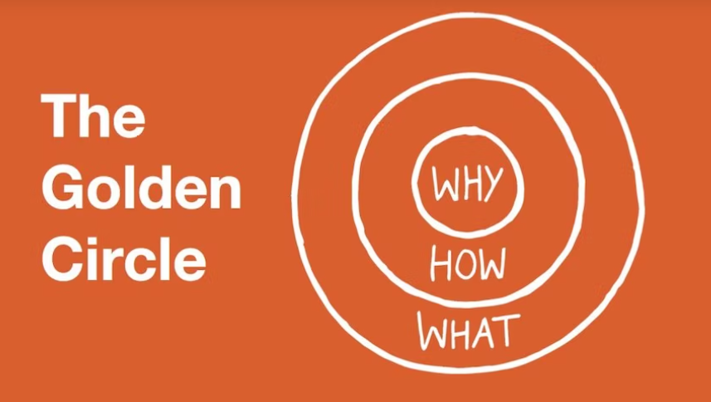

Slide 64
2. Brand vision
Once you have your “why” it’s time to determine a vision statement. This defines what it is you want to achieve.
So, grab a pen and paper and get scribbling some answers to these helpful questions:
Think about where you would like your business to be in five to ten years
Write the statement based on your “why” and your business’ values

Slide 65
Make sure that your statement implies a clear focus for your business
Write your vision statement in the present tense
Distill your statement into clear and concise language
Make sure the statement is easily understood.
Check with friends and family that your vision is clear

Slide 66
3. Check your competition and find your unique selling point
From your competition, research them and work out what it is that sets your brand or company apart.
Your unique selling point (USP) comes from positioning yourself differently from your competitors.

Slide 67
A handy checklist for finding your USP:
Make a list that includes all the features and benefits that are unique about your product or service.
Google your competitors and compare your features and benefits, then you can get a clearer picture of what small thing (or big thing) sets you apart.
Think about an emotional need that will be met by your product or service.

Slide 68
Look at it from your customer’s point of view and note down everything that springs to mind.
Identify aspects of your product or service that your competitors cannot imitate.
Underline anything that cannot be easily duplicated, reproduced, or copied.
Think of phrases about your unique product or service, keep them clear and concise.

Slide 69
4. Personality counts
Establishing the right personality for your brand will help prospective customers decide on whether you are the right brand for them.
Personality should be reflected throughout your communications from the tone of voice and language to the type font and colors you choose.

Slide 70
All of this will be reflective of your brand values and ultimately your prospective customers’ values.
Brand creation relies on truly understanding the buyer persona. It helps visualize your target customers and their demographics, like age, gender, location, income.

Slide 71
To get even more definition for your brand’s buyer persona, you can explore these details:
Motivations
Goals
Fears
Desires
Influencers
Brand affinities

Slide 72
5. Pitch perfect
Referring to your tone of voice with this principle, your communications with your target audience must speak to them directly and connect with them.

Slide 73
6. Creating brand guidelines
Time for the final principle, now you have thoroughly researched and worked out your unique offer, it’s time to create brand guidelines.
So, here’s what your brand guidelines should include:
Company logo and strapline
Color palette
Typography
Document styling
Digital styling

Slide 74
Identification of brand design principles
There are certain fundamental principles that branding agencies adhere to while creating the visual and style guidelines of a brand. There are as follows: 1. Research, Vision and Design Brief
2. Logo, Identity & Guidelines
3. Monitoring and Rebranding

Slide 75
1. Research, Vision and Design Brief
What are the seven fundamental questions to help you towards a killer design brief?
How is the brand perceived against competitors?
What is the positioning statement of the brand?
What is the heritage of your product type and the origins of its ingredients and fabrication?
Who is your audience?
Where will the company have contact with them?
What values and beliefs should the brand have about the business and it’s mission in the world?
What benefits do you want customers to associate with your brand?

Slide 76
Once agencies have the answers to these questions they proceed from the research phase to the theoretical phase, which includes the following points:
1. Who is the target audience?
2. What are the messaging objectives?
3. What are the values of the brand?
4. What are the brand’s offerings?

Slide 77
The best branding companies also ensure to understand the external factors such as:
1. Budget for building the brand identity
2. The timelines and schedule of the project
3. The compatible formats and color schemes
4. Other practical needs

Slide 78
2. Logo, Identity & Guidelines
Once the brand consultant is clear with the findings from the research, he or she will work with the designer to establish the logo and other important identity.
The logo is the central, identifiable visual element that helps customers discover, share and remember a company’s brand.
The style guidelines is a visual document that prescribes the logo usage rules, typeface system, color palette, layout guidelines and more.

Slide 79
3. Monitoring and Rebranding
Brand identity is a living, breathing thing that might need to evolve as it interacts with consumers.
The challenge with rebranding is to maintain familiarity and consistency so that your customers remember you.

Slide 80
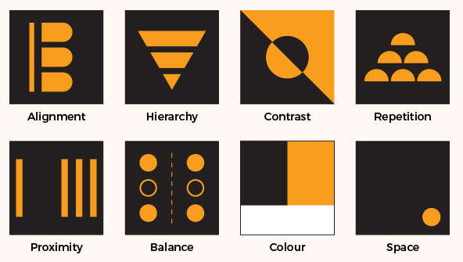
Eight Design Principles

Slide 81
Eight basic principles of design exist to help designers create amazing work :
Alignment: Creating a sharp, ordered appearance for elements to connect with each other.
Hierarchy: Ordering elements in terms of big, medium, and small to give extra visual weight to the most important message.
Contrast: Drawing out important elements of design to add emphasis. For example, black and white, thick and thin, modern and traditional.
Repetition: Tying design and overall look together, which helps people remember brands and important information better. Consistent fonts, colours, and brand imagery fall under this category.

Slide 82
Proximity: Space between elements, or group of elements to create a relationship between the designs.
Balance: Helping viewers look through content in a way that aids comprehension – balance can be achieved symmetrically, while asymmetrical balance uses contrast to even out the flow of the design.
Colour: Colour theory helps connect your brand to users on an emotional and subconscious level. For our article on colour theory, please click here.
Space: The activeness of the “passive” white space, which helps create space and breathability to highlight important information.

Slide 83
Identification of Brand Personas
A brand persona is a collection of personality traits, attitudes and values that your brand showcases on a regular basis to help connect with a certain audience segment. A brand persona can be a person, character, mascot or idea.
5 Key Branding Personas
Historically, brand personas fit into several different “buckets" based on human behavior. If you are new to personas, this is a good place to start.
Caregiver: This nurturing persona is empathetic and kind.

Slide 84
Competent: This persona is an influential leader that can help users or sway them to act.
Excited: This spirited persona is happy to do just about anything and embarks on adventures with ease.
Rugged: This more muscular persona is athletic and tough.
Sophisticated: This persona exudes elegance, style and prestige.

Slide 85
Identification of Brand Competition
Competitors are other businesses who can offer the same or similar goods and services to your customers.
Brand competition is the competition between companies or organizations that offer similar products or services in the same market.
These companies compete to achieve higher revenue, market share or growth.
Identifying the brands that you compete with influences your marketing and overall business strategies.

Slide 86
Principles of branding design:
1. Design is brand: This sentence has never been truer than now. In 2016, when the majority of big brands take the social media call, branding and design became so close that they are now inseparable
2. Integration: Even though they emerged as two different disciplines, design and branding need to be integrated if you want them to be effective.
A product cannot do without its brand image, and brand image is nothing without design.

Slide 87
3. Understanding the brand: The more you know, the better you are as an expert. This is true when it comes to the design process.
If a designer does not understand your company’s core values, your deepest origins and the mission of your product or service, the design process and the end-product might fall short of a great story behind it.

Slide 88
4. Relationships: People respond to emotion. If they cannot connect with a brand or make a relationship happen, you know it will not work for either side.
It is a designer’s responsibility to make an emotion-evoking design, similarly to what Apple has done with their products
with which their users feel a deep connection. iPhones, and that is something that would not work without a good branding design.

Slide 89
5. Strategy: What many startups and small companies do not realize is that they need to employ a branding strategy early on, from the very founding of the company.
6. Innovative solutions: In a world where almost every product and every service are the same as another, it is hard not to have similar ideas and use the same concepts for certain work.
The designers, however, need to be there to make things different from one another and offer innovative design solutions that will leave their competition behind.

Slide 90
7. Reinvention: Many companies today use their branding options to reinvent the brand and yet retain the same image in the eyes of their audience.
8. Do not overdesign: When one starts the creative process, it is very difficult not to get carried away and do more than required, even to the point of ruining the entire concept.
9. Making a difference: Many people forget about this important thing, but this principle relies on being different than everyone else.
No matter if you work on the local or global market, you have got to have what it takes to step out and say:

Slide 91
Identification of Brand Competition
Brand Competition can be defined as the conflict between the companies offering the similar line of products or services in the same target market and to the same target audience with the goal to have the higher market share, increased revenues, huge profits, and growth as compared to the contemporary brand at the marketplace.
Knowing and astutely understanding the competitors of your brand is one of the crucial steps to plan and execute a successful business strategy.

Slide 92
Types of brand competition
Here are some common types of brand competition:
1. Direct competition
2. Indirect competition
3. Replacement competition
4. Intra-brand competition

Slide 93
1. Direct competition
Direct competition occurs when companies within a market have comparable features and benefits and present their products or services to the same target demographic of customers.
This kind of competition typically involves two companies that follow similar marketing strategies and sales goals.
A brand can distinguish itself from a direct competitor by highlighting the advantages of its product or the reputation of its brand.
When 2 or more businesses offer the same products or services and competent for the same potential market.

Slide 94
Direct competition example
There is always a direct competition between the two smartphone mobile companies namely Apple and Samsung and the even the customers of both the brand are always at an argument endorsing the mobile brand that they are loyal to.
There is always a competition between the two brands on the facets of mobile interface, design aesthetics, and the overall user experience.

Slide 95
2. Indirect competition
Indirect competition refers to the competition between two companies that offer similar products or services but emphasize unique features and benefits.
The indirect competition also includes companies that utilize separate marketing strategies.
This type of competition is less prominent than direct competition, but it's still important for a company to identify forms of indirect competition to gain an understanding of the features that influence a customer's decision.
Indirect competitors are businesses in the same category that sell different products or services to solve the same problem.

Slide 96
Indirect competition example
Mobile brands Apple and Oppo are the indirect competitors of each other as Apple is majorly into luxury segment and Oppo offer the affordable range of cell phones.
Their brand strategies, target audience, and business goals are also different.

Slide 97
3. Replacement competition
Replacement competition is when a company's customers purchase from competitors.
This occurs when customers who were previously loyal to your brand give their business elsewhere.
Replacement competition includes companies that make products that differ from each other but serve the same customer purpose.
A replacement competitor offers an alternative to the product or service that you offer. You both seek to solve the same pain points, but the means are different.

Slide 98
Replacement competition example
Oakville Cable realizes that there is a decrease in its rate of new customer acquisition and that existing customers have been canceling their accounts.
After conducting research, Oakville Cable determines that this is because Lamplight Streaming, a digital streaming platform, has become more popular and has seen an increase in its customer accounts.
Both companies provide television and movie programs, but Lamplight Streaming has a wider variety and does not include advertisements or commercials in its content.
To address this competition and bring in new customers, Oakville Cable decides to partner with an internet provider to offer bundled cable and internet services to customers at an affordable price.

Slide 99
4. Intra-brand competition
Intra-brand competition occurs when separate retailers or distributors sell products of the same brand.
This competition is between the providers rather than the brands.
Retailers or distributors may use promotional prices, marketing strategies or customer service skills to reach higher sales numbers or larger profits.

Slide 100
Intra-brand competition example
Favorite Jeans is a brand of women's denim pants and products. Jeans Online is an online retailer that sells multiple brands of jeans, including Favorite Jeans, at a discount.
Total-Mart department store also sells Favorite Jeans in its women's department at normal retail prices.
Both stores sell the same product from the same brand, but Jeans Online may have limited stock and sizing options, even though customers can conveniently shop at home.
Conversely, Total-Mart has an in-person shopping environment and may be able to hold more inventory.
The two retailers compete to sell the same product by emphasizing distinct advantages and environments for consumers.

Slide 101
Tips for addressing brand competition
Here are some tips an organization may use to address brand competition and promote customer retention:
Researching competitors
Knowing the features and benefits of other brands in your target market improves your ability to meet the needs of customers or to develop new features that provide a competitive advantage.

Slide 102
Analyzing the customer's purchasing process helps you find an effective marketing strategy.
Once you understand what the customer desires from a product, you can show them why your brand is the best option for their specific purposes.
Understanding why a customer purchases from a competitor can also highlight where your brand can improve to offer a better experience for customers.

Slide 103
Observing and improving marketing strategies
When another brand that offers a similar product is more successful, it may be because of its marketing.
Effective marketing identifies and targets the key groups of consumers most likely to purchase or use a product or service.
Creating marketing that reaches and excites your audience can influence them to purchase your products or services and remain loyal to the company.
Observing the successful components of a competitor's marketing messages can help you identify strategies and features that generate positive customer responses and can translate into the company's own marketing practices.

Slide 104
Definition of tasks
“a task refers to any activity that is usually observable and has a start and an end point.”
So, in task analysis, UX designers first research how users complete tasks by asking them to perform a specific activity and observing how they do so—from start to finish.
Understand product specifications and user psychology
Interpret data and qualitative feedback
Create user stories, personas, and storyboards
Define the right interaction model and evaluate its success
Develop wireframes and prototypes around customer needs
Find creative ways to solve UX problems (e.g. usability, findability)
Work with UI designers to implement attractive designs
Communicate design ideas and prototypes to developers

Slide 105
Maintaining brand quality
Ensuring that a brand maintains the quality of its products and services can encourage customers to continue making purchases.
Product and customer service quality can boost sales and promote a positive brand reputation.
This sense of satisfaction and consistency can also aid in gaining new customers through word-of-mouth marketing and overall brand recognition.

Slide 106
Identification of Brand Personas
Personas are fictional(imagined) characters, which you create based upon your research in order to represent the different user types that might use your service, product, site, or brand in a similar way.
Personas help designers to create understanding and empathy with the end users.
User personas help designers shape product strategy and accompany during the usability testing sessions.
User Personas: A technique that supports designing and engineering interactive systems with focus on the end-users. The common understanding of the personas technique is that a persona is a description of a fictitious person based on data collected about the target user group.

Slide 107
Identification of end user Pain Points
Definition
Pain points: Pain points are areas of difficulty or frustration that users experience with a product or service.
They can be related to usability, customer service, pricing, or any other aspect of the user experience.
Pain points can have a significant impact on the user experience, and understanding them is essential for creating a successful product.
Pain points: are a specific problem that customers or prospective customers of your business are experiencing in the marketplace. They are essentially any problems that the customer may experience along their customer journey.
Pain points: are problems that occur at the different levels of the customer experience: interaction level, customer-journey level, or relationship level.

Slide 108
Common types of pain points
Pain points can be divided into two main categories: usability pain points and customer service pain points.
Usability pain points are related to the usability of a product or service, such as difficulty navigating the website, slow loading times, or confusing navigation menus.
Customer service pain points are related to customer service, such as long wait times, unhelpful customer service agents, or lack of response to customer inquiries.

Slide 109
Three Levels of Pain Points
Interaction-level pain point: A user is passed from support person to support person.
Customer pain points at the interaction level are related to interactions with the products of an organization and its employees.
A key example of an interaction-level pain point is a customer not having an issue dealt with in a timely manner because they are directed to multiple departments who might not be equipped with the resources or knowledge to rectify it.
As a result, this confuses the customer and ultimately wastes their time.
Journey-level pain point: A user places an order and does not receive it for months.
Journey-level pain points refer to friction and frustration encountered by customers when they are attempting to get from point A to B.
Examples of pain points relating to customer journeys include customer support wait times, slow communication, and long durations between critical points of the customer journey.
Relationship-level pain point: A user pays for a service but still has to watch ads.
Lastly, relationship-level pain points comprise the issues experienced by customers that are long-term and concern their feelings towards the brand or organization.

Slide 110
The three levels of user pain points(summary)
Interaction-level: pain points relating to interactions with an organization’s products and team members.
Journey-level: pain points pertaining to customer and user journeys.
Relationship-level: pain points customer experience during their lifetime with a brand.

Slide 111
The Effects of Pain Points on Users
All pain points incur:
a cost to users : Example, the interface may be so complicated that the user may need to call for assistance (and thus experience an increase in interaction cost).
a time cost : for instance, if the user needs to wait for a long time for a process to complete.
There is also a financial cost to the user: For example, if an internet provider has frequent outages, users may be forced to use their cellphones as hotspots and incur extra data costs.

Slide 112
Definition of Tasks
Task analysis is a process that helps UX designers learn how users actually go about completing tasks with a product.
A user experience (UX) designer is responsible for improving user interaction with a product, whether a website or application, by helping users achieve their goals quickly and smoothly.
UX designers use task analysis when developing their product to gain insight and receive feedback from users.

Slide 113
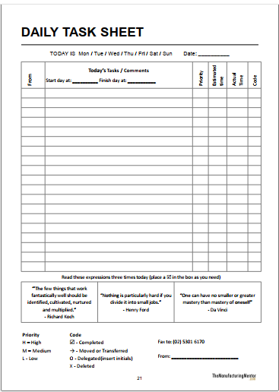

Slide 114
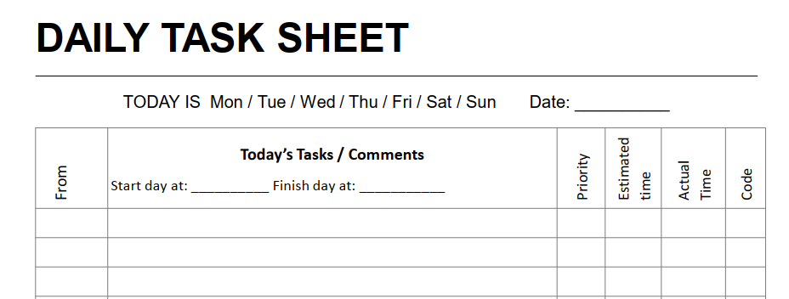
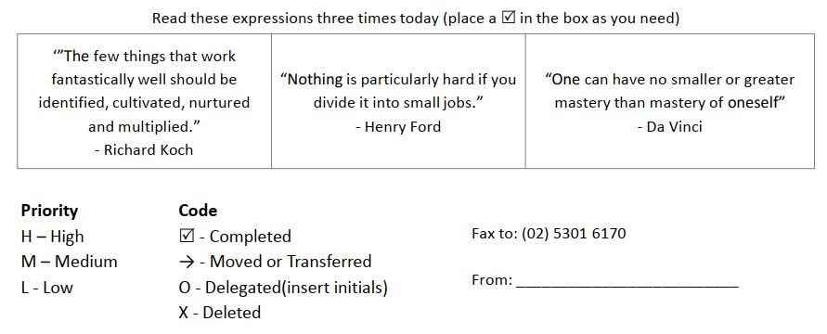

Slide 115
steps
Understand product specifications and user psychology
Interpret data and qualitative feedback
Create user stories, personas, and storyboards
Define the right interaction model and evaluate its success
Develop wireframes and prototypes around customer needs
Find creative ways to solve UX problems (e.g. usability, find ability)
Work with UI designers to implement attractive designs
Communicate design ideas and prototypes to developers

Slide 116
Learning outcome 2. Define User
Definition of key terms:
User story: A user story is a well-formed, short and simple description of a software requirement from the perspective of an end-user, written in an informal and natural language.
A user story describes the type of user, what they want and why.
A user story helps to create a simplified description of a requirement.
User story: A tool in Agile software development used to capture a description of a software feature from a user's perspective. The user story describes the type of user, what they want and why. A user story helps to create a simplified description of a requirement.

Slide 117
User personas: User personas are representations of an app or Web site’s various user groups.
UX designers and product teams use them to help them create the best possible user experience.
The personas they create should represent the types of people that would most likely utilize an app or Web site.

Slide 118
User journey: A user journey map is an excellent tool for UX designers because it visualizes how a user interacts with a product and allows designers to see a product from a user’s point of view.
User Journey: A path a user may take to reach their goal when using a particular website.
UX brief (UX project brief): A UX project brief: is different from a traditional creative brief. Instead of dictating project expectations, the team creates a project brief at the kickoff (start or beginning) meeting.
This process creates a useful document to help get everyone aligned on a project’s intended goals and outcomes

Slide 119
Creation of user story
1. Characteristics of user story
To build a good user story, we focus on six characteristics. A good story should have characteristics.
Bill Wake described six characteristics of a good user story. We entitle his formula as “INVEST”.
I) Independent
N) Negotiable
V) Valuable
E) Estimable
S) Small
T) Testable

Slide 120
Independent: The user story should be independent of all others. Because they are not connected, they can be worked on in any order.
Don’t build in unnecessary or overly complicated contingencies between stories
Negotiable: A user story should be flexible enough to allow for negotiation between the customer and product owner.
Don’t add too much detail to stories, because they should be works in progress
Valuable: What value does the user story bring? If you cannot find any value, the story should not be completed.
The basic act of writing a story should prove its business value to the user.
User Stories should clearly reflect the values of the user or customers; the best approach is to allow customers to write the story.

Slide 121
Estimable: You should be able to estimate how long a user story will take so that you can effectively manage your time.
Development team needs to estimate a user story in order to determine priorities, workload scheduling.
Write stories so that developers can break them down into smaller stories and doable(feasible) tasks.
Small: The user story must be small enough to be completed within a single sprint.
A good story on the amount of work to be as small as possible, preferably not more than 10 people over the workload / day, at least make sure that in one iteration or Sprint that can be completed.
Testable: You must be able to test your user story in line with quality assurance standards.
The story must be testable. Successfully passed the test developers can prove that correctly implements the story.

Slide 122
Another system, SMART, means stories should be:
Specific : A task needs to be specific enough so that everyone can understand it.
Everyone should easily understand the goals.
Measurable : The key of measure is, “can we mark it as done?”
With objective ways of measuring whether the story is done.
Achievable: The task owner must be able to achieve task.
Acceptance criteria are agreed-upon in advance.
Realistic/relevant: Every task must be relevant and story contributing
The story can be achieved, given the resources at hand
Time-based/time boxed: Every task must be relevant and story contributing.
There is enough time to build it.

Slide 123
2. Benefits of user stories
User stories serve a number of key benefits:
1. Stories keep the focus on the user. A to-do list keeps the team focused on tasks that need to be checked off, but a collection of stories keeps the team focused on solving problems for real users.
2. Stories enable collaboration. With the end goal defined, the team can work together to decide how best to serve the user and meet that goal.

Slide 124
3. Stories drive creative solutions. Stories encourage the team to think critically and creatively about how to best solve for an end goal.
4. Stories create momentum. With each passing story, the development team enjoys a small challenge and a small win, driving momentum.
Momentum: Momentum is just about every activity that involves motion.

Slide 125
3. Create user story
Five steps for writing user stories
Want some practical advice on how to write user stories? Use these five steps as a guide:
Step 1: Outline acceptance criteria
The definition of done is the set of criteria that needs to be fulfilled for your user story to be considered complete.
Define the specific acceptance criteria for each user story and use it as a checklist.

Slide 126
Step 2: Decide on user personas
Conduct extensive user research by creating surveys, hosting focus groups, and reading user forums.
Analyze your data and search for patterns to identify your key personas.
Step 3: Create tasks
Break your user story down into numerous tasks to make it more manageable. If it is a complex requirement, you can also add subtasks.
Include detailed descriptions, so your team is aligned on what each task requires.

Slide 127
Step 4: Map stories
Use story mapping to structure work in a large process.
In this case, your user stories will take the form of ordered steps.
Step 5: Request feedback
Speak to users and potential customers to find out what they want.
Ask them for their opinions on existing products or if they have suggestions for new features. Incorporate this feedback into your user story.

Slide 128
User story examples
Most user statements take the form of: “As a [persona], I want to [their goal], so that [the reason for their goal].”
In this concise format, they explain:
Who the user is
What the user is trying to do
Why do they want to do it.

Slide 129
User story example 1
As a banking customer, I want to transfer money from one account to another on my phone so I don’t have to do it on a computer.
Who the user is: A banking customer
What they’re trying to do: Transfer money between accounts on a mobile app
Why they want to do it: Make money transfers more easily, especially on the go
Developers now know that, from a user’s perspective, speed and convenience are important, and a simple mobile interface will be key.

Slide 130
Identification of user personas
✓ Importance of user personas
User personas help designers shape product strategy and accompany during the usability testing sessions.
Personas generate empathy; and empathy is essential to the DNA of UX design.
Personas allow you to look at a personal representation of your users and come to a better understanding of what your real users’ needs and goals look like in real moments of their lives.
empathy :the ability to understand and share the feelings of another.
Deoxyribonucleic acid (abbreviated DNA) is the molecule that carries genetic information for the development and functioning of an organism.

Slide 131
Characteristics of user personas
Here are a few characteristics of a good persona:
Personas aren’t fictional guesses at what a target user thinks.
Every aspect of a persona’s description should be tied back to real data (observed and researched).
2. Personas reflect real user patterns, not different user roles.
Personas aren’t a reflection of roles within a system.
3. A persona focuses on the current state (how users interact with a product), not the future (how users will interact with a product).
4. A persona is context-specific (it’s focused on the behaviors and goals related to the specific domain of a product).

Slide 132
User personas in design process
How do user personas help the design process?
User personas can be used in lots of ways across different departments in an organization. There are 3 key reasons to use them though that provide value.
Firstly, the original reason personas were developed is to give us a point of reference for who we’re designing for.
If you don’t understand your users when designing a website, the work you do is really just guesswork (albeit based on experience and expertise) but how can you be sure you are meeting the user’s actual needs?
If your personas are accurate, you can make informed decisions about what users are trying to do, what features you need to include and the priority of information they are looking for, which in turn helps you plan content architecture.

Slide 133
Secondly, it gives project stakeholders something tangible to consider.
When working with an organization that has a middle management structure, it can sometimes be difficult to sell the value of UX Design, especially when dealing with non-creative people.
Lastly, it gives us something to test against.
A user persona is really only useful if you use it to define outcomes. And a defined outcome can only provide value if you later come back to it and review your goals.
When a project is completed, in order to review its success, you need to look at whether you have improved things for the user. Your user persona is therefore a great artifact for this.

Slide 134
Creating user personas in design process
The research that goes into forming user personas usually happens early in the design process.
In the Design Thinking process, designers often start creating personas during the second phase, the Define phase.
Like most design elements, personas can be developed iteratively.
Personas will be used during all later phases of a design process to inform design decisions made by the team.

Slide 135
User personas in design process
✓ The design-thinking framework follows an overall flow of
understand,
explore, and
materialize.
Within these larger buckets fall the 6 phases: empathize, define, ideate, prototype, test, and implement.

Slide 136
1. Understand (Empathize, Define)
Empathize: Conduct research in order to develop knowledge about what your users do, say, think, and feel.
Define: Combine all your research and observe where your users’ problems exist. In pinpointing your users’ needs, begin to highlight opportunities for innovation.

Slide 137
2. Explore (Ideate, Prototype)
Ideate: Brainstorm a range of crazy, creative ideas that address the unmet user needs identified in the define phase.
Give yourself and your team total freedom; no idea is too farfetched and quantity supersedes quality.
At this phase, bring your team members together and sketch out many different ideas.
Then, have them share ideas with one another, mixing and remixing, building on others' ideas.

Slide 138
Prototype: Build real, tactile representations for a subset of your ideas.
The goal of this phase is to understand what components of your ideas work, and which do not.
In this phase you begin to weigh the impact vs. feasibility of your ideas through feedback on your prototypes.

Slide 139
3. Materialize (Test, Implement)
Test: Return to your users for feedback. Ask yourself ‘Does this solution meet users’ needs?’ and ‘Has it improved how they feel, think, or do their tasks?’
Implement: Put the vision into effect. Ensure that your solution is materialized and touches the lives of your end users.

Slide 140
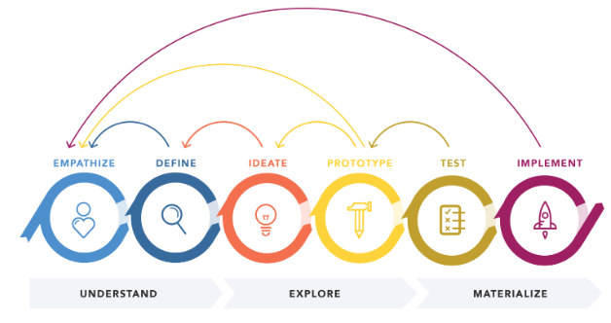
Steps of creating user personas

Slide 141
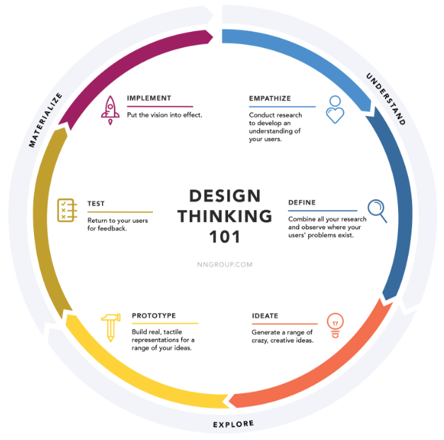

Slide 142
Creation of user journey
Types of user journey map
A user journey map gives a visual representation of a customer’s experience.
This visualization might cover a customer’s entire relationship with a brand or focus on a select experience they might have while interacting with an app or website.
1. UX journey map:
Journey Maps are a UX visualization document that showcases the steps that a user takes in a process to accomplish a goal.
Personas are created with information gathered from user and stakeholder interviews.
As a result of these activities, you can identify the most important functionality an audience needs.

Slide 143
2. Sales journey map: A journey map lays out all touch points that your customer may have with your brand – from how they first heard of you through social media or brand advertising, to their direct interactions with your product, website, or support team – and includes all of the actions your customer takes to complete an objective across ...
3. Customer experience journey map:
A customer journey map is a visual storyline of every engagement a customer has with a service, brand, or product.
The creation of a journey map puts the organization directly in the mind of the consumer, so they can see and understand their customer’s processes, needs, and perceptions.
OR

Slide 144
A customer journey map is a diagram (or several diagrams) that depict the stages customers go through when interacting with a company, from buying products online to accessing customer service on the phone to airing grievances on social media. Depict: illustrate, represent, characterize, detail,…
Airing: transmission
Grievances: injustice, wrong, complaint, criticism, objection, disservice

Slide 145
Elements of a user journey map
1. Persona: What segment of users are you trying to understand (current or target)? Scenario: What interaction are you trying to map out (real or anticipated)?
2. Scenario: What interaction are you trying to map out (real or anticipated)?
3. Stages of the journey: What are the high-level phases of the scenario?
4. User actions: What actions can the user take in each stage of the journey?

Slide 146
5. User emotions and thoughts: What is the user’s emotional state as they move through the stages? What are they thinking in each stage?
6. Opportunities: Where can you improve the UX of your product or connect with your customer in a more effective way?
7. Internal ownership: Which team or team member will be responsible for enacting these changes?

Slide 147
Create user journey map
basic steps to create your own user journey map:
1. Define the scope.
Creating a helpful user journey map starts with defining your goals.
Being clear on your goals now can help give you more relevant insights once your map is complete.

Slide 148
2. Build user personas.
Think about who your users are, and create a persona for each segment.
This often starts with user research. User interviews, focus group discussions, surveys, and even prior user feedback can help you develop these personas.

Slide 149
3. Define user goals, expectations, and pain points.
Once you have a better idea of who your target user is, spend some time thinking about what they want.
What problem do they have that your product or service can solve?
What expectations might they have as they begin their journey?
What problems might they face, or what about your product might cause them frustration?

Slide 150
4. List out touch points and channels.
The term “touch point” refers to a point of interaction between a user and a product or business.
These touch points can occur across many different business channels, including websites, social media platforms, apps, ads, or face-to-face communications.
Create an inventory of all the touch points and channels involved in the scenario you’ve previously defined.

Slide 151
5. Map the journey.
You’ve gathered the data you need to populate your map, so now it’s time to visualize this information.
This is where you can get creative. Your map could be as simple as a timeline or as complex as a storyboard that shows visually what happens in each phase.
You could take a low-tech approach with sticky notes on a whiteboard, or go digital with an Excel spreadsheet or software program.

Slide 152
6. Validate and refine the map.
Your user journey map is only as strong as it is truthful.
Validate the map by moving through the user journey yourself.
Usability testing, analytics, and user reviews can also help validate that your map reflects the user reality.
Continue to refine the map as you discover discrepancies

Slide 153
● Perform UX Research
Your objective as a UX researcher is to empathize and uncover truths about your customers they may not even know themselves.
It’s important to ask great questions, and use different methods to get to the insights you’re seeking – and to avoid your own cognitive biases in the process.

Slide 154
Best practices for conducting UX research
Start with clear objectives in mind Involve key stakeholders early to determine key objectives of the research project.
Make your findings easy to understand Visualize key insights to be digestible and easily understood by all stakeholders, considering there will often be a range of technical proficiencies.
Plan for an iterative process: Forming a UX research strategy

Slide 155
1. Create a plan
Once you have defined your goals and outlined hypotheses, you can create a plan for how to conduct research. A plan usually includes:
Objectives: What are the goals? What questions are you trying to answer?
Hypothesis: What assumptions are you making? What do you think will happen?
Methods: What research method are you using?
Audience: Who are you gathering insight from?
Schedule: What is the timeline?
Internal participants: Who at your organization will be involved?

Slide 156
2. Identifying stakeholders
Who should be involved in conducting UX research?
The answer: anyone who is involved in understanding and designing for this group of users.
This could include designers, product managers, content strategists, developers, and even marketers.
You can get started by mapping out your stakeholders and their roles in the process.

Slide 157
3. Collect baseline research
Begin with baseline research, which covers what you already know about users. You may have a competitive analysis or user personas that already exist.
Now that you have your research plan and have selected the methods you’d like to use to gather data from your audience, it’s time to put it into action. Remember, UX research is about observing, understanding, and analyzing.
Start by observing your users through the UX research methods you’ve chosen.

Slide 158
4. Synthesize findings
Once you’ve finished conducting your research, it’s time to make it understandable and actionable by turning qualitative and quantitative data into insights.
As you comb through everything, try organizing it on this board – you can even divide and conquer by recording findings as a team.

Slide 159
Learning outcome 3: Design Mockup
Description of Key Concepts
✓ User interface: The user interface is the point at which human users interact with a computer, website or application.
Interface: point where two systems, subjects, organizations, etc. meet and interact
According to the definition there are types of user interfaces and examples of user interface

Slide 160
The various types of user interfaces include
1. Graphical User Interface (GUI) :
The interface that allows users to interact with electronic devices, such as computers, laptops, smartphones and tablets, through graphical elements.
Its goal is to present the user with decision points that are easy to find, understand and use.
In other words, GUI lets you control your device with a mouse, pen or even your finger.
The GUI process lets you click or point to a small picture, known as an icon or widget, and open a command or function on your devices, such as tabs, buttons, scroll bars, menus, icons, pointers and windows.

Slide 161
examples of GUI input control elements:
Buttons: Buttons are circles that let you make immediate choices and take actions. Radio buttons come in groups where only one button can be selected at a time.
Checkboxes: Checkboxes are square boxes in a list of one or more options. When you click the box, it stays selected. They are best presented in a vertical list.
A checkbox can be a single box, such as acknowledging a statement, or a list of related items, such as a shopping list.
Date picker: A date picker lets you select a date and/or time. The creator can choose a calendar or a fill-in option.
It ensures that a consistent format is used, such as “day, month, year.”

Slide 162
Dropdown lists: Dropdown lists lets you select one item at a time. Several items can be included compactly.
Consider adding directions, such as “select one” to let the user know what to do. The creator can add or delete items to keep the list up to date.
List boxes: List boxes let you select multiple items from one compact list. Use this GUI feature if you have a long list of options for the user to consider.

Slide 163
There are four variations of list boxes: single-line, multiselect, multiselect with checkboxes and multiselect-dual list boxes.
Text boxes: Text boxes are fields that let you enter text. The creator can control how much text is allowed.
Toggles: Toggle buttons let you change a setting typically as off/on states.

Slide 164
2. command line interface (CLI)
Command-line interface (CLI) is that interface in which we interact with the computer by entering commands. An example of CLI is MS-DOS in Windows and terminal in MAC and Linux. You can type commands to download files, copy files, move files, delete files etc.
OR
A command-line interface (CLI) is a text-based user interface (UI) used to run programs, manage computer files and interact with the comp
Command-line interfaces are also called command-line user interfaces, console user interfaces and character user interfaces.
Or
A command line interface (CLI) is a computer program that runs on text-based inputs to execute different tasks. Instead of pointing and clicking with a mouse, it receives single-line commands that interact with system elements like file management.

Slide 165
How does command line interface work?
CLI program takes text-based commands from users and processes them, then displays the output on the same screen.
Users must be prompt in entering their single-line command input to make the most of this application.
3 types of CLI commands:
System commands are encoded as part of the operating system.
Executable programs run text-based or graphical applications.
Batch programs are text files that list a sequence of commands. They can include both system commands and executable programs.

Slide 166
3. menu-driven user interface
A menu-driven interface is a type of interface in which menus are displayed on the screen and the user click on those menus to perform different tasks.
In Windows, you can click on the start menu and it displays other menus. Similarly, websites or apps also have a menu on top or left of the screen. You can open other web pages of the website by clicking on menus.
In your car, the LED screen has also a menu’s by which you play a video or audio.
A UI that uses a list of choices to navigate within a program or website. For example, ATMs (Automated Teller Machine) use menu-driven UIs and are easy for anyone to use.

Slide 167
4. Touch user interface
User interface through haptics or touch. Most smartphones, tablets and any device that operates using a touch screen use haptic input.
Haptics (pronounced HAP-tiks) is the science of applying touch (tactile) sensation and control to interaction with computer applications.

Slide 168
5. voice user interface (VUI)
Interactions between humans and machines using auditory commands.
Examples include virtual assistant devices, talk-to-text and GPS.
A global positioning system (GPS) is a network of satellites and receiving devices used to determine the location of something on Earth.

Slide 169
6. form-based user interface
A form-based interface is an interface by which the user fills a form and submit it to the website. As you can see that any website has a contact us page.
You fill a form on the contact us page and that form is submitted to the admin of the website.
Similarly, you have heard about Google forms that are used to get data of users who fill the form.
The HTML forms have different fields like text field, text area, upload button, drop-down menus, radio buttons. These all are components of the form.

Slide 170
7. natural language user interface:
A natural language interface is a user interface in which the user and the system communicate via a natural (human) language.
The user provides input via speech or some other method, and the system generates responses in the form of utterances delivered by speech, text or some other method.
Or
Natural-language user interface (LUI or NLUI) is a type of computer human interface where linguistic phenomena such as verbs, phrases and clauses act as UI controls for creating, selecting and modifying data in software applications.

Slide 171
Examples of user interfaces
Some examples of user interfaces include:
computer mouse : You can interact with the screen by mouse, keyboard, finger touch, by voice command.
Take an example of a shopping app. You as a user place order on the app by interacting with the app.
You can select different options on the app, i.e. selecting a size, quantity, price, delivery option.
Finally, you complete your order on the app.

Slide 172
2. remote control : For example, the remote control is a hard device by which users can interact with the TV screen.
You can have any design on the screen and you interact with it.
The design that is displayed on the screen is the interface and you as a user interact with it.

Slide 173
3. virtual reality : dealing with sensitive information on the internet.
4. ATMs (Automated Teller Machine ): is an electronic machine that dispenses cash or performs other banking services when an account holder inserts a bank card without the aid of a branch representative or teller.

Slide 174
User experience
The user experience (UX or UE) is how a user interacts with and experiences a product, system or service. It includes a person's perceptions of utility, ease of use, and efficiency.
User Experience Basics
User experience (UX) focuses on having a deep understanding of users, what they need, what they value, their abilities, and also their limitations.
Factors that Influence UX
At the core of UX is ensuring that users find value in what you are providing to them. Peter Moville represents this through his User Experience Honeycomb

Slide 175
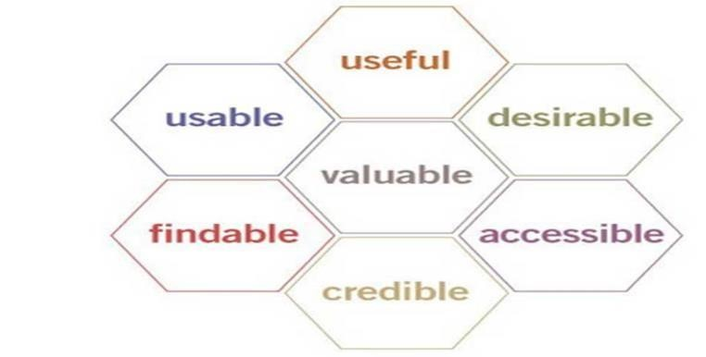

Slide 176
He notes that in order for there to be a meaningful and valuable user experience, information must be:
Useful: Your content should be original and fulfill a need
Usable: Site must be easy to use
Desirable: Image, identity, brand, and other design elements are used to evoke emotion and appreciation
Findable: Content needs to be navigable and locatable onsite and offsite
Accessible: Content needs to be accessible to people with disabilities
Credible: Users must trust and believe what you tell them

Slide 177
Importance of UI/UX design in Software Development
1. Usability
A working application is great. However, people are less likely to use (or continue to use) if it’s not user-friendly.
Time spent on the UX and UI interface is designed to attract and retain users for your application.
2. Allows people to understand
Deploying an app with a poor user experience offers a lasting look. Before deployment, you can identify and resolve problems so your first impression is good.
A user-friendly app keeps people from leaving. Your software is an integral aspect of your life. Your application will be used by new users as its usability is known.
You must consider the needs of your customers before designing the Ul UX.

Slide 178
3.Establishes your brand
Attractive applications have more users and they’re a reality. The popular UI / UX has attracted several millions of uses, apps like Twitter, Instagram, Facebook, etc. The happiness from a great user experience makes users trustworthy.
4.Lower costs and time management
You have a very little risk that your clients would have an issue with your application if you invest in a great UI / UX design. A great product does not need regular updates so you save money and time on an update. The upgrade needs some money-and-time expenses. Losses for your company will occur.
The effective architecture of UX and UI saves development time. Mock-ups and prototypes smooth out problems before a long period of production. You keep track of the release date so you are less likely to go back and redo development work.

Slide 179
In Conclusion
The role of UI/UX in the creation of apps is important. Most developers build a high performing device but do not concentrate on the nature that causes the device to fail.
The functionality of the application is difficult to combine with UI UX design, but it is important to do that.

Slide 180
Important principles of user experience design
UX design is the process of creating products and services that solve a specific user problem, while ensuring that the proposed solution is both easy and enjoyable to use.
It takes a lot to get the user experience just right and there are many different factors to consider.
The most important UX design principles that all designers should know about:

Slide 181
Clarity: the measure of how effectively visual design prioritises and conveys information. It is determined by all the components of a webpage that can stimulate visually. Clarity produces meaningful, unobstructed interaction. It is, also, instrumental when perceiving something as beautiful.
User-centricity:
User-centricity basically means putting the user’s needs first and making decisions based on what you know about them and what they want from the product.

Slide 182
Hierarchy
Hierarchy is an important UX design principle as it shapes how the user navigates a product — and how easy or complicated the process is.
Usability
Usability is, quite simply, a measure of how easy a product is to use.

Slide 183
Consistency:
It is essential to keep your designs consistent in terms of how they look and function across all pages/screens and products within the same brand or product family.
User control:
The principle of user control is all about helping users to correct or reverse errors without throwing the entire user experience into disarray. You can build user control and freedom into your product by incorporating “Undo” and “Redo” functionality, providing “Cancel” buttons and clearly labelling alternative actions and routes the user can take if they want to revert a particular action.
Comfort
Accessibility:
Accessibility is about ensuring your product or service is accessible to and usable for as many people as possible. It includes catering to the needs of people with disabilities, as well as understanding how different environments or situational factors might impact the user experience.

Slide 184
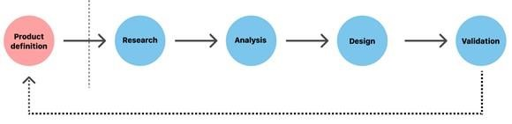
UX design process key phases
1. Product definition
2. Product research
3. Analysis
4. Design
5. Validation (Testing)

Slide 185
1. Product definition
One of the most important phases in UX design is actually done before the product team creates anything.
Before you can build a product, you need to understand its context for existence. The product definition phase sets the foundation for the final product.
During this phase, UX designers brainstorm around the product at the highest level (basically, the concept of the product) with stakeholders.
This phase usually includes:
Stakeholder interviews: interviewing key stakeholders to gather insights about
business goals.
Value proposition mapping: thinking about the key aspects and value propositions of the product: what it is, who will use it, and why they will use it.
Concept sketching: creating an early mockup of the future product (can be low-
Fidelity per sketches of the product’s architecture).

Slide 186
2. Product research
Once you’ve defined your idea, the product team moves to the research phase.
This phase typically includes both user research and market research. This phase can include:
Individual in-depth interviews (IDI). A great product experience starts with a good understanding of the users.
Competitive research. Research helps UX designers understand industry standards and identify opportunities for the product within its particular niche.

Slide 187
3. Analysis
The aim of the analysis phase is to draw insights from data collected during the research phase, moving from “what” users want/think/need to “why” they want/think/need it.
During this phase, designers confirm that the team’s most important assumptions are correct.
This phase of the UX process usually includes:
Creating user personas. Personas are fictional characters that represent the different user types for your product.
As you design your product, you can reference these personas as realistic representations of your target audience.
Creating user stories. A user story is a tool that helps designers understand the product/service interactions from the user’s point of view.
Storyboarding. Storyboarding is a tool that helps designers connect user personas and user stories. As the name suggests, it’s essentially a story about a user interacting with your product.

Slide 188
4. Design
When users’ wants, needs, and expectations from a product are clear, product designers move to the design phase. At this step, product teams work on various activities, from creating information architecture (IA) to the actual UI design. The design phase usually includes:
Sketching. Sketching is the easiest and fastest way to visualize our ideas.
Creating wireframes. A wireframe is a tool that helps designers visualize the basic structure of a future page, including the key elements and how they fit together.
Creating prototypes. While wireframes are mostly about structure and visual hierarchy (the look), prototypes are about the actual interaction experience (the look and feel).
Creating design systems. For large projects, designers typically create a system of components, patterns, and styles that help both designers and developers stay on the same page regarding the design.

Slide 189
5. Validation (Testing)
Validation is an essential step in the design process because it helps teams understand whether their design works for their users.
The validation phase of the UX process may include the following activities:
“Eat your own dogfood.” Once the design team has iterated the product to the point where it’s usable, it’s time to test the product in-house.
Testing sessions. User testing sessions with people who represent your target audience are very important.
There are many different formats to try, including moderated/unmoderated usability testing, focus groups, beta testing, and A/B testing.
Surveys. Surveys are a great tool for capturing both quantitative and qualitative information from real-world users
Analytics. Quantitative data (clicks, navigation time, search queries, etc.) from an
analytics tool can be very helpful to uncover how users interact with your product.

Slide 190
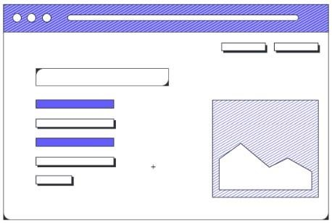
Wireframe
Figure that show wireframe

Slide 191
What is a wireframe?
A wireframe is a skeletal blueprint or framework that outlines the basic design and functions of a user interface (such as a website or application).
The goal of a wireframe is to quickly and easily communicate:
The contents of the page
The page structure and layout
The app’s functions
In other words, a wireframe describes the basic structure, functions, and content of the page.
Wireframes can be low-fidelity or high-fidelity, depending on your needs and preferences.
A low-fidelity :wireframe is often sketched out on paper or a whiteboard and is a useful way to brainstorm the basic outline for your design.
A high-fidelity :wireframe has more detail and may include simple workflows and interactions.

Slide 192

Mockup

Slide 193
What is a mockup?
A mockup is the next, more in-depth iteration of the wireframe outline. A mockup is a static wireframe that includes more stylistic and visual UI details to present a realistic model of what the final page or application will look like.
A good way to think of it is that a wireframe is a blueprint(plan) and a mockup is a visual model.
A mockup typically includes additional visual details such as:
Colors, styles, graphics, and typography
Styled buttons and text
Navigation graphics
Component spacing
Mockups are useful tools for understanding and communicating what the final interface should look like and gives stakeholders a chance to preview design and style choices before committing to building the app in a functional prototype.

Slide 194
Prototype

Slide 195
A prototype is “A simulation or sample version of a final product, which UX teams use for testing before launch.”
The goal of a prototype is to test and validate ideas before sharing them with stakeholders and eventually passing the final designs to engineering teams for the development process.
Prototypes are essential for identifying and solving user pain points with participants during usability testing.
Testing prototypes with end-users enables UX teams to visualize and optimize the user experience during the design process.

Slide 196
Distinction from wireframe, mockup and prototype

Slide 197
Distinction from wireframe, mockup and prototype
● A wireframe is a quick sketch of a product intended to convey its desired functionalities.
● A mockup is a realistic design of a product designed to gather feedback on its visual elements.
● A prototype is an interactive simulation of a product designed to test the user experience.

Slide 198
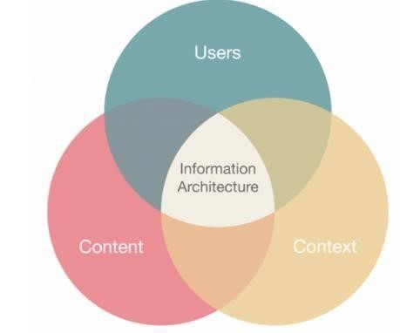
information architecture
What is information architecture?
Figure that show the components of information architecture

Slide 199
Information architecture is a discipline that focuses on the organization of information within digital products.
For example, when designers create apps and websites, they lay out each individual screen so that the user can easily find the information they need.
They also create a flow that lets users navigate between screens without much effort.
UX architects determine the right organization and flow.

Slide 200
Design thinking process
What is design thinking?
Design thinking is a methodology that attempts to solve complex problems in a creative and user-centric way. Core features of the design thinking methodology include:
Focus on end-users. The end-user plays a key role in the design thinking process—all key product design decisions are evaluated according to the end user’s needs and wants.
Solid problem framing. Rather than accepting the problem as given, designers explore the problem space to find a root cause of the problem. The insights they gain can help designers reinterpret the given problem.
Creating tangible solutions. Convey design solutions using sketching and prototyping as opposed to presentations and slide decks.

Slide 201
The design thinking stages are:
Empathize. Understand the problem of the user for whom you are designing.
Define. Form a problem statement.
Ideate. Generate creative solutions to this problem.
Prototype. Build a tangible representation of this solution.
Test. Validate this solution

Slide 202
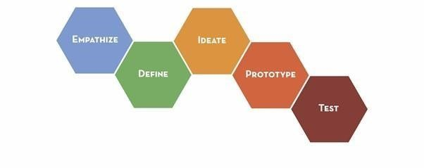

Slide 203
User-centered design
User-Centered Design Basics
The User-centered design (UCD) process outlines the phases throughout a design and development life-cycle all while focusing on gaining a deep understanding of who will be using the product.
The following are the general phases of the UCD process:
Specify the context of use: Identify the people who will use the product, what they will use it for, and under what conditions they will use it.
Specify requirements: Identify any business requirements or user goals that must be met for the product to be successful.
Create design solutions: This part of the process may be done in stages, building from a rough concept to a complete design.
Evaluate designs: Evaluation - ideally through usability testing with actual users - is as integral as quality testing is to good software development.

Slide 204
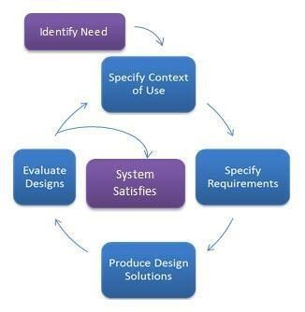
Figure for phases of the UCD process

Slide 205
Usability
Usability Testing can be defined as the kind of testing performed from the end user's point of view for determining whether the application you are developing is effortlessly usable or not.
Your application may build entirely per the requirements. Still, they might not be used at the time of delivering the project in the user's hands.
Here's a simple block diagram of usability testing below:

Slide 206
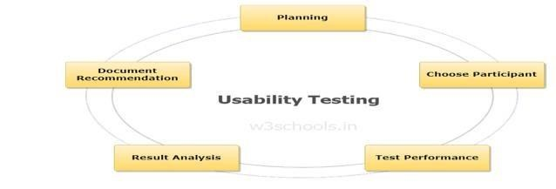
Figure for steps of usability testing

Slide 207
3-Clicks rule
The 3-click rule is a persistent, unofficial heuristic that says that no page should take more than 3 clicks (or taps on a touchscreen) to access.
A variation pronounces that the most important information should take no more than 3 clicks to get to.
The 3click rule assumes that users will become frustrated and will likely give up on tasks that require more than three total clicks to be completed.
It is a simple way of assessing the interaction cost of important information-seeking tasks, but its superficial simplicity is also its downfall.

Slide 208
Feedback
Feedback in UX: [Presenter] One of the most important mechanisms we employ in UX is feedback. Feedback is the system's response to the user's action.
If you've ever submitted a form and not received a response, you've likely felt confused on whether the system worked and whether you had to do it again.
Feedback gives users the confidence that their action was acknowledged by the system.
Feedback is incorporated into everything we design, from how buttons behave on click to receiving an email confirmation on your new account signup.
Essentially, according to Hogue, feedback answers questions across four categories:
Location: Where am I?
Current Status: What’s happening — and is it still happening?
Future Status: What will happen next?
Outcomes & Results: What just happened?

Slide 209
Use of Figma prototyping tool
Figma’s prototyping features allow you to create interactive flows that explore how a user may interact with your designs.
✓ Setup Figma
Step 1: Get access to Figma Create or sign in to your Figma account ...
Step 2: Enable the component libraries Open the design file you’d like to connect to the DDS 2 libraries.
Step 3: Manage components Components are listed in the Assets panel.
Step 4: Integrate styles
Step 5: Review updates

Slide 210
Figma interface
Canvas
Frames
Menu
Layers
Design
Panel
Pages
Inspect
Panel
Options
Prototype
Assets
Figma Mirror

Slide 211
Sketch wireframe
● Sketch mockup
✓ Setting up files
Creating file
Create and edit frames
Creating pages
✓ Management of layers

Slide 212
✓ Application of contents in design
Adding predefined shapes
Add custom shapes
Pen tool
Add Images
Masking
Effects and blending
Strokes
Management of layout (Auto-layout, Grid, Row, Columns)Application of element alignments
✓ Creation of color palettes

Slide 213
✓ Creation of components
Reusable input components
Reusable checkbox and radios
Reusable button components
Content cards
✓ Application of mockup design
Content sections
Navigation bar
Sidebar menu
Dropdown menu
Design simple online shopping platform with Items listing, cart, checkout
Design authentication pages
Design a B2B platform
✓ Test design using Figma Mirror

Slide 214
Presentation of Prototype
✓ Starting prototyping
✓ Adding interactivity to the design
✓ Present Prototype

Slide 215
Written assessment
1.Answer True or False
a. user interface (UI): is also the way through which a user interacts with an application or a website.
b. computer mouse and remote control are the types of UX.
c. quantitative is statistical and can be computed data while qualitative is insights that can be observed but not computed.
d. Pain points are problems that occur at the different levels of the customer experience: interaction level, customer-journey level only.
e. Direct Competition is faced by the brand from the other companies in the market that offer the similar lines of products having comparable features and benefits plus to the same target market and target customers.

Slide 216
2.What are the Principles of branding design?
3. Give the difference between user story and user scenario/6marks
4. What stand for the following abbreviation/
HTTP, HTML.CSS, WWW, TCP, IP, UX, UE, UI, URI, URL
5. Name any three types of user interface
6. Outline the five steps of UI/UX Design Process
7. What means or stand for SMART and INVEST for user story
8.Enumerate three levels of pain points in UX design
9. Match the following steps in user personas process with their phases.

Slide 217
Empathize, Define | Materialized
Ideate, Prototype | Explore
Test, Implement | Understand

Slide 218
10. Complete the following sentences using the given word: brand, brand identity, creative brief, story, Brand Competition, user story, user scenario, User personas
………………. is the unique set of brand associations that represent what a brand stands for and promises to its customers? Or ……………. are the visible elements of a brand, such as color, design, and logo, that identify and distinguish the brand in consumers' minds?
……………is a name, term, design, symbol or any other feature that distinguishes one seller's good or service from those of other sellers.
……………… is representations of an app or Web site’s various user groups.
……….. is like the smallest unit of work in the frame work or tiny piece of a stable fundament of a successful application according to design, function and its process.
…………….. is just the written definition of a UX Designer’s first visualization of the first wireframes and prototypes? First approach is visual.
……………..can be defined as the conflict between the companies offering the similar line of products or services in the same target market and to the same target audience with the goal to have the higher market share, increased revenues, huge profits
…………. is a detailed description of what users do with the product and more importantly why they do it?
……………. is a document used to outline the strategy of a creative project?
11. Discuss about the types of the UX Research Methods Matrix

